Slide 1

CS4347 Database Systems
Dallas Mavericks Basketball
By Smaran Voora, Jahanzeb Bastaki, Surya Mallidi, Payson Eberz, Deonte Hewell, Akintunji Sule, Britney Abner, Rohan Sanyal, Aarez Ali Momin

Slide 2
Introduction
Why:
Our passion for the game of basketball
The Dallas Mavericks is our favorite team to watch
To show fans and analysts insight as to organizational management and improvements to be made
What:
Stores not only players, coaches, and games, but also the organizational structure
No sensitive data is included in the database
Each of the entities are connected to other entities to show impacts between them
Notes:
For the why: on the improvements points, you can mention how this was due to the 2023-2024 seasonal loss even though they got to the finals

Slide 3


Background
We will:
Basketball-Reference
Real GM
Covers all teams
provides information on
player statistics
assistant coaches
training staff
Covers all teams
Additionally provides contract info
Specialize in the Dallas Mavericks
Provide details about executive staff
Show relationships between every part of the team
Notes:
For the why: on the improvements points: you can mention how this was due to the 2023-2024 seasonal loss even though they got to the finals
Talk about how our project is similar and different:
Similar: Basketball-Reference and RealGM are known for extensive coverage of player data and team statistics, both of which overlap with the goals of our project
Different: We have Contracts, hierarchies between different entities, organizational structure which most stats websites do not take into account, and its all focused on a single team not multiple

Slide 4
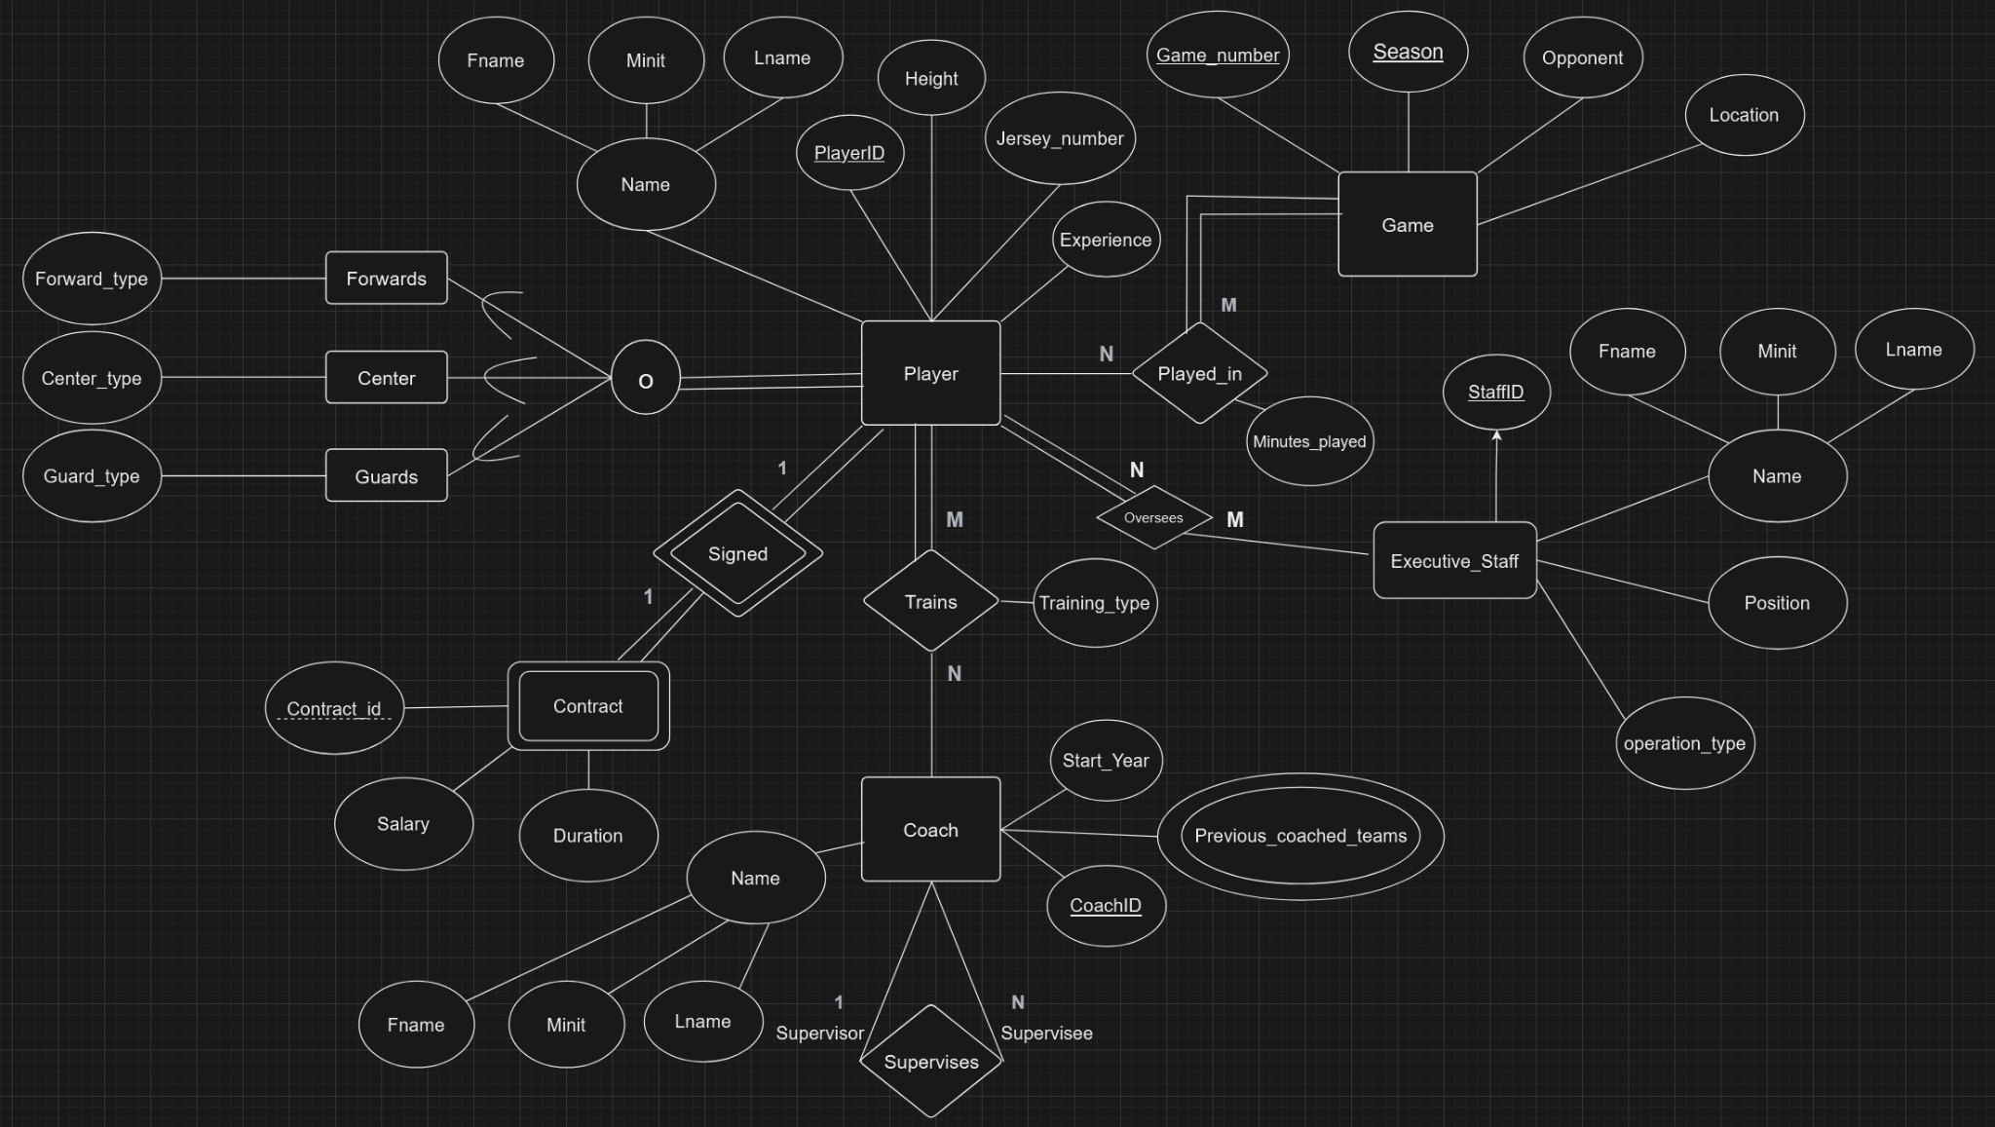
EER Diagram
Important entities
Player
Game
Coach
Contract
Exec_staff

Slide 5
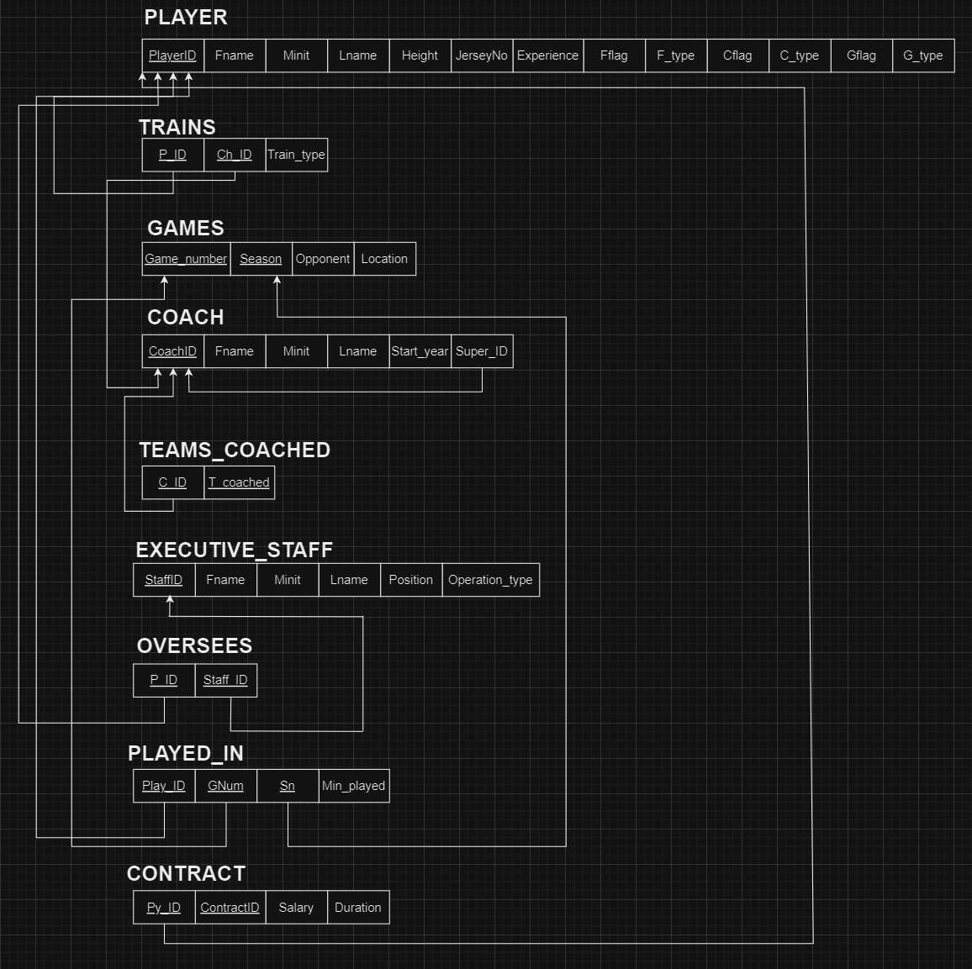
Normalized Relational Model
Notes:
Talk about why we didnt change it and important relationships

Slide 6
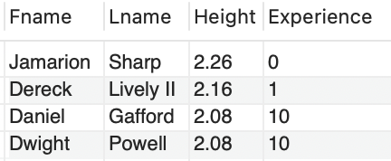
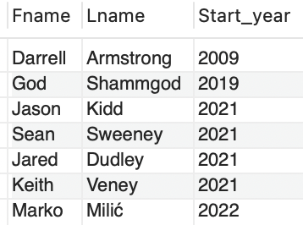
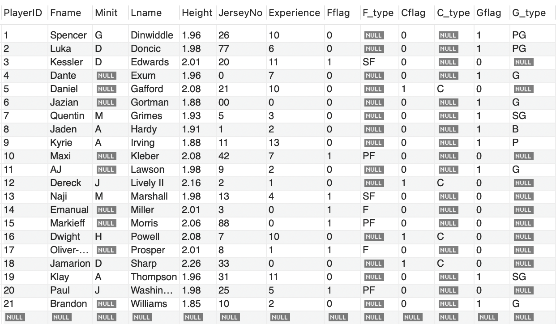
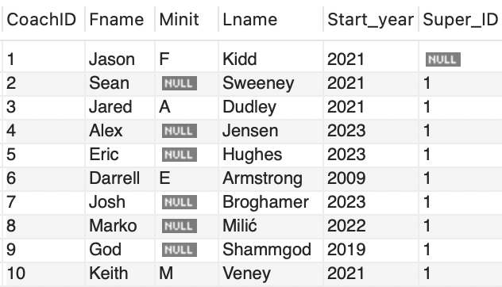
Query
SELECT Fname, Lname, Height, Experience FROM Player
WHERE Cflag = true
ORDER BY Experience ASC;
SELECT Fname,Lname,Start_year
FROM Coach
WHERE Start_year <= 2022
ORDER BY Start_year ASC;
<- Queries->
<- Results ->
<- Base Tables->

Slide 7
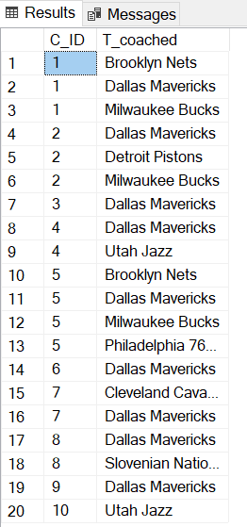
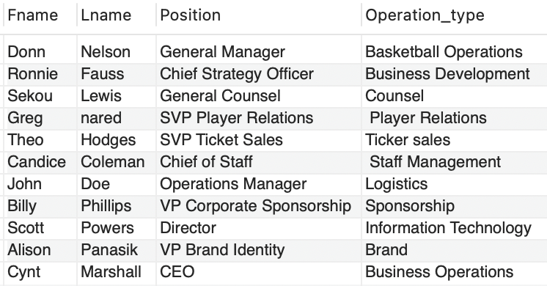
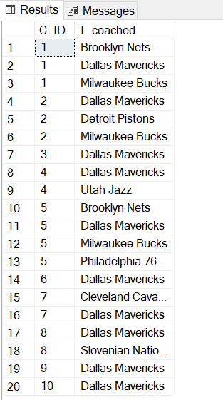
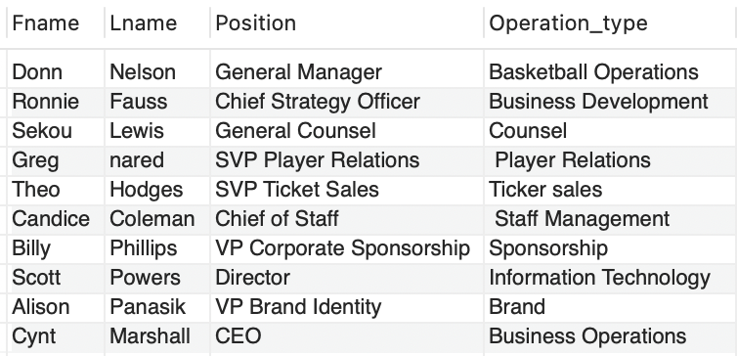
Insertion of Values
INSERT INTO Executive_Staff (StaffID, Fname, Minit, Lname, Position, Operation_type)
VALUES
(6873, 'John', 'A', 'Doe', 'Operations Manager', 'Logistics');
INSERT INTO Teams_coached (C_ID, T_coached)
VALUES
(10, ‘Utah Jazz’);
<- Queries->
<- Results ->
<- Base Tables->

Slide 8
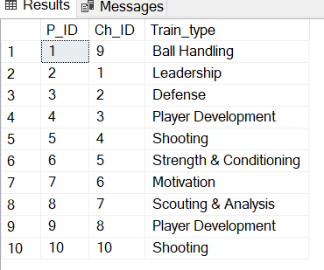
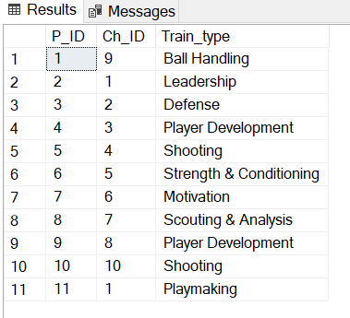
Deletion
DELETE
FROM Trains
WHERE Train_type = ‘Playmaking’;
DELETE
FROM Coach
Where CoachID = 11;
<- Queries->
<- Results ->
<- Base Tables->

Slide 9
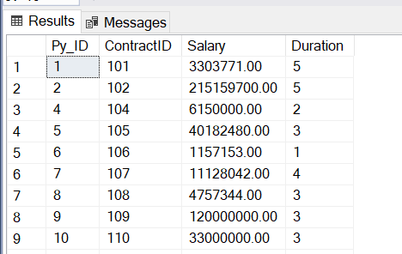
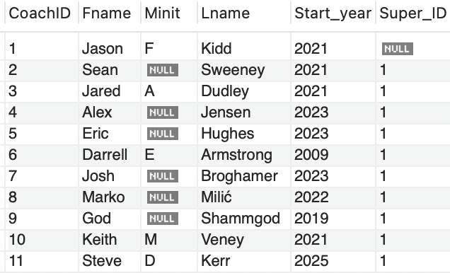
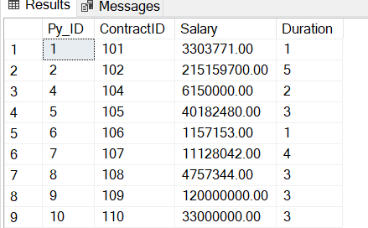
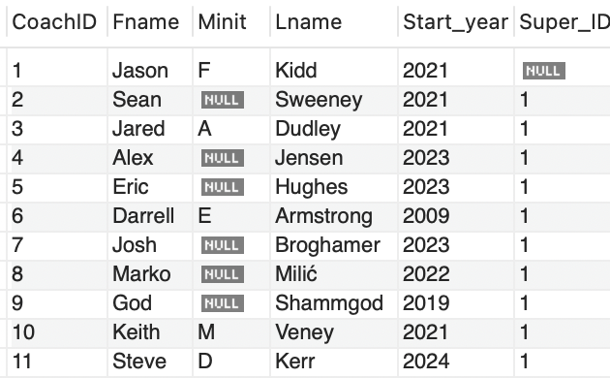
Update
UPDATE Coach
SET Start_year = 2025
WHERE CoachID= 11;
Update Contract
Set Duration = 5
Where ContractID = 101
<- Queries->
<- Results ->
<- Base Tables->

Slide 10
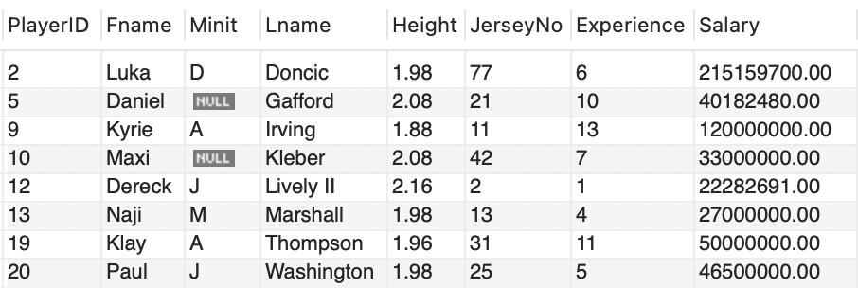
View Execution
HighSalaryPlayers
CREATE VIEW HighSalaryPlayers AS
SELECT
p.PlayerID,
p.Fname,
p.Minit,
p.Lname,
p.Height,
p.JerseyNo,
p.Experience,
c.Salary
FROM
Player p
INNER JOIN
Contract c
ON
p.PlayerID = c.Py_ID
WHERE
c.Salary > 14000000;

Slide 11
Frontend Demo
Notes:
Talk about the technology used for the frontend

Slide 12
Conclusion
This project successfully developed a comprehensive database system for the Dallas Mavericks organization.
The system integrates data on players, games, coaches, contracts, and executive staff, providing a holistic view of the organization.
Detailed modeling of relationships between entities allows for a deeper understanding of organizational dynamics and facilitates data-driven insights.
By focusing exclusively on the Mavericks, this database provides a specialized tool for fans, analysts, and potentially the team itself.

Slide 13
Future Work
Expand Scope:
Incorporate additional data types like advanced player metrics, historical comparisons, and fan engagement statistics.
Improved User Interface:
Develop a more user-friendly front-end for real-time query execution and visualization.
Integration:
Link the database with external APIs (e.g., NBA stats) for real-time data updates.
Machine Learning Integration:
Use the data for predictive analytics, such as player performance forecasting or game outcome predictions.
Deployment:
Host the database on a cloud platform for accessibility and scalability, enabling widespread use by external stakeholders.

